Slide 1

Project Title: Crafting Compelling Web Presences
Name: Yuva Raj Gopinath
BATCH: MBE4

Slide 2
“Start where you are. Use what you have. Do what you can”
- Arthur Ashe

Slide 3
Project task 1: Understand their products or services and create short descriptions for a minimum of 3 and a maximum of 5 products or services.
As a Digital Marketing Intern or Trainee at Intellect Design Intellect Design - Future Ready Multiproduct Fintech Platform, I would be happy to provide you with short descriptions of some of their products and services:
1.Intellect Digital Core: This is a comprehensive banking platform that enables banks to offer a wide range of services to their customers. It includes features such as account management, payments, loans, and more. The platform is designed to be flexible and scalable, allowing banks to customize it to their specific needs.
2.Intellect Digital Origination: This is a solution that helps banks and financial institutions streamline their loan origination process. It includes features such as application processing, credit scoring, and document management. The solution is designed to be user-friendly and can be integrated with other banking systems.

Slide 4
3.Intellect Digital Wealth Management: This is a platform that helps wealth management firms and advisors manage their clients' investments. It includes features such as portfolio management, risk analysis, and performance reporting. The platform is designed to be customizable and can be tailored to meet the specific needs of each client. 4. Intellect Digital Payments: This is a solution that helps banks and financial institutions process payments quickly and securely. It includes features such as real-time payments, mobile payments, and digital wallets. The solution is designed to be flexible and can be integrated with other banking systems. 5. Intellect Digital Anti-Money Laundering: This is a solution that helps banks and financial institutions comply with anti-money laundering regulations. It includes features such as transaction monitoring, customer due diligence, and risk assessment. The solution is designed to be scalable and can be customized to meet the specific needs of each institution.

Slide 5
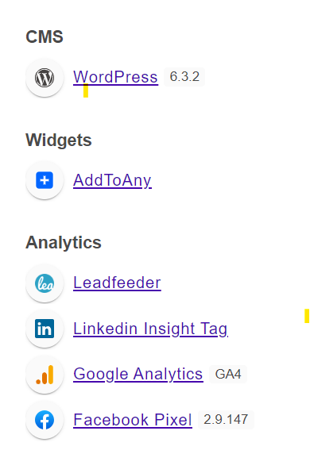
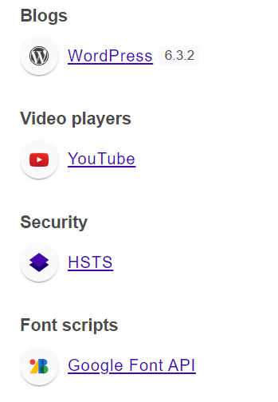
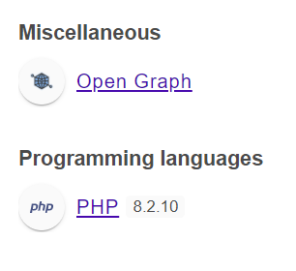
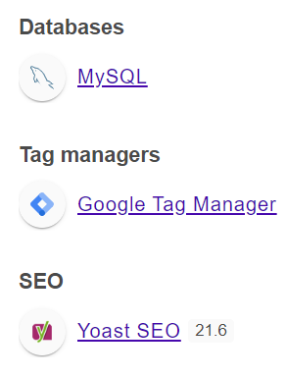
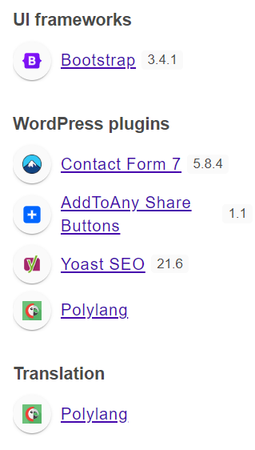
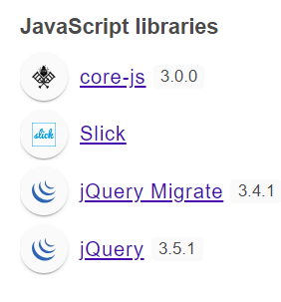
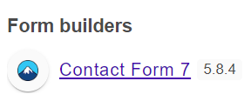
Task 2: Determine the platform on which the website is developed (Use online tools to identify).
I have used Wappalyzer online tool to identify on which platform this Website is developed.

Slide 6

Task 3: Test the website's responsive design and mobile optimization (Share the report). Test a minimum of 5 pages (Use Online Tools to find).
Testing results for 1st Page – https://emach.ai/index.html and
below are my observations
Mobile View (375 x 667) – All looks Good in Page presence.
iPad View (1024 x 768) – All looks Good in Page presence.
Laptop View (1440 x 900) – All looks Good in Page presence.
Desktop View (1920 x 1080) – All looks Good in Page presence.
Issues Found: Slow page loading time.
Recommendations: Images, videos, and other media files with large file sizes can significantly slow down page load times. Optimizing these files for the web by compressing them or using formats like WebP can help reduce load times.

Slide 7
Testing results for 2nd Page – https://www.intellectdesign.com/careers/
Mobile View (375 x 667) – Some Images are not loading.
iPad View (1024 x 768) – Some Images are not loading.
Laptop View (1440 x 900) – Some Images are not loading.
Desktop View (1920 x 1080) – Some Images are not loading.
Issues Found: Most of the images are not loading in both Desktop and mobile views.
Recommendations: This page is not creating a good user experience on both mobile and desktop views, that needs to be fixed.
Testing results for 3rd page - https://www.intellectdesign.com/
Mobile View (375 x 667) – All looks Good including page load time.
iPad View (1024 x 768) – All looks Good including page load time.
Laptop View (1440 x 900) – All looks Good including page load time.
Desktop View (1920 x 1080)– All looks Good including page load time.
No Issues Found in the Home Page.

Slide 8
Testing results for 4th Page - https://www.intellectdesign.com/design-thinking/
Mobile View (375 x 667) – All looks Good including page load time.
iPad View (1024 x 768) – All looks Good including page load time.
Laptop View (1440 x 900) – All looks Good including page load time.
Desktop View (1920 x 1080)– All looks Good including page load time.
No Issues Found
Testing results for 5th Page - https://www.intellectdesign.com/contact-us/
Mobile View (375 x 667) – All looks Good including page load time.
iPad View (1024 x 768) – All looks Good including page load time.
Laptop View (1440 x 900) – All looks Good including page load time.
Desktop View (1920 x 1080)– All looks Good including page load time.
Recommendations:
If applicable, consider embedding an interactive map that displays the location of your organization's offices or branches. This can make it easier for visitors to visualize your physical presence and navigate to your location.

Slide 9
Include a clear and compelling call-to-action (CTA) that prompts visitors to take the next step, whether it's filling out a contact form, requesting more information, or scheduling a consultation. Make the CTA stand out visually and place it prominently on the page.
Consider integrating live chat support functionality on the contact page to provide real-time assistance to visitors. This can improve customer service and help address any questions or concerns immediately.

Slide 10
Task 4: Identify common website design mistakes to avoid, such as cluttered layouts and slow loading times. (List at least 5 suggestions).
Slow Loading Times: Speed matters. Large images and unoptimized code can slow down your site. Optimize images, combine CSS and JavaScript files, and leverage browser caching to improve loading speed and user experience.
Poor Navigation: Confusing navigation frustrates users. Create clear, intuitive menus, organize content logically, and offer breadcrumbs for easy navigation through your site's hierarchy.
Unreadable Text: Legibility is key. Small, hard-to-read fonts and poor contrast make content inaccessible. Opt for readable font sizes, high-contrast color schemes, and sufficient spacing for enhanced readability and accessibility.
Lack of Mobile Responsiveness: With mobile usage soaring, responsive design is non-negotiable. Ensure your site is optimized for various screen sizes and resolutions, delivering a seamless experience across devices.

Slide 11
Cluttered Layouts: A cluttered website overwhelms visitors, hindering their ability to find information easily. Ensure a clean and organized design with ample whitespace to guide users' focus and enhance readability.
Ignoring SEO Best Practices: Don't let your site go unnoticed. Neglecting SEO means losing out on visibility and traffic. Incorporate relevant keywords, optimize meta tags and image alt text, and follow other SEO best practices to improve your site's search engine ranking and discoverability.

Slide 12
Task 5: Provide a list of best practices for creating visually appealing and user-friendly website designs.
Sleek and Minimalist Layouts: Embrace simplicity by using clean designs with ample whitespace, which not only looks modern but also enhances readability and focus.
Seamless Navigation: Craft intuitive navigation menus that guide users effortlessly through your site, ensuring they can easily locate the information or products they seek.
Unified Branding Elements: Maintain consistency in your brand presentation across all pages, employing harmonious color schemes, fonts, and imagery to reinforce your brand identity.
Adaptive Design for All Devices: Cater to the diverse needs of users by employing responsive design principles, guaranteeing a seamless browsing experience regardless of the device they use.
Swift Loading Times: Prioritize optimization techniques to expedite loading times, such as compressing files, utilizing caching mechanisms, and leveraging CDNs, all of which contribute to a snappier user experience.

Slide 13
6.Polished Visuals: Elevate your website's aesthetic appeal with high-resolution images and tasteful graphics, providing a visually captivating experience that resonates with your audience.
7.Legible Typography: Opt for legible fonts and appropriate sizes to ensure text remains easy to read across different screens, fostering accessibility and user engagement.
8.Inclusive Accessibility: Embrace inclusive design practices to accommodate users with diverse needs, adhering to accessibility standards like WCAG to ensure equal access to all.
9.Interactive Multimedia: Enhance user engagement by integrating multimedia elements like videos, animations, and interactive features, which captivate attention and enrich the browsing journey.
10.Strategic Call to Actions: Strategically position clear and compelling calls to action (CTAs) that prompt users to take desired actions, such as making a purchase or subscribing to your newsletter.
11.User-Friendly Forms: Simplify form completion with user-friendly designs featuring clear labels, helpful tooltips, and real-time validation, minimizing user friction and increasing form submissions.

Slide 14
Task 6: Design a landing page for their product or service to generate leads. (Use Mockup or Figma or Any other tools to show the design)
I've meticulously crafted a captivating landing page, meticulously curating every element to resonate with our brand identity and effectively convey the value proposition of our product/service. Through dedicated effort and attention to detail, I've transformed our vision into a compelling reality, driving user engagement and conversion using a tool ‘Figma’. Take a look of my Landing Page with the below link,
https://www.intellectdesign.com/

Slide 15


